Slide 1

QueryBuilder and Custom Predicates
Viktor Kadol

Slide 2
Outline
What is QueryBuilder & Predicates?
Predicates from the box.
Custom predicates.
Debugging

Slide 3

What is QueryBuilder & Predicates?

Slide 4

Search In AEM
Common approaches: XPath, SQL2, QueryBuilder
QueryBuilder
path=/content
1_property=sling:resourceType
1_property.value=foundation/components/text
1_property.operation=like
SQL2
select * from [nt:base] as a where [sling:resourceType] like
'foundation/components/text' and isdescendantnode(a, '/content')
XPath
/jcr:root/content//*[jcr:like(@sling:resourceType, 'foundation/components/text')]

Slide 5
What is QueryBuilder?
IS
Syntactic sugar API over XPath that accepts a query description(predicates), create and run an XPath query, optionally filter the result set, and also extract facets, if desired
IS NOT
Query Engine itself
Search optimization tool (index or cache)

Slide 6
Ways to use QueryBuilder
Search Service Default Servlet( /bin/querybuilder.json /bin/querybuilder.feed )
Java API: HashMap
Map<String, String> map = new HashMap<String, String>();
map.put("path", "/content");
map.put("type", "cq:Page");
map.put("p.offset", "0"); // same as query.setStart(0) below
map.put("p.limit", "20"); // same as query.setHitsPerPage(20) below
Query query = builder.createQuery(PredicateGroup.create(map), session);
HTTP Request Params
PredicateGroup pg = PredicateGroup.create(request.getParameterMap())
Query query = builder.createQuery(pg , session);
Predicates combination
PredicateGroup pg = PredicateGroup.create(request.getParameterMap())
pg.add(new Predicate("path").set("path", "/content"));
pg.add(new Predicate("type").set("type", "cq:Page"));
Query query = builder.createQuery(pg , session);
Query Builder Debugger ( /libs/cq/search/content/querydebug.html )

Slide 7
What predicate is?
Description for single logical search term or condition.
Exists
1_property.operation=exists
1_property=submitted
Equals
1_property.operation=equals
1_property=jcr:title
1_property.value=Apples
Result count:
p.limit=-1

Slide 8
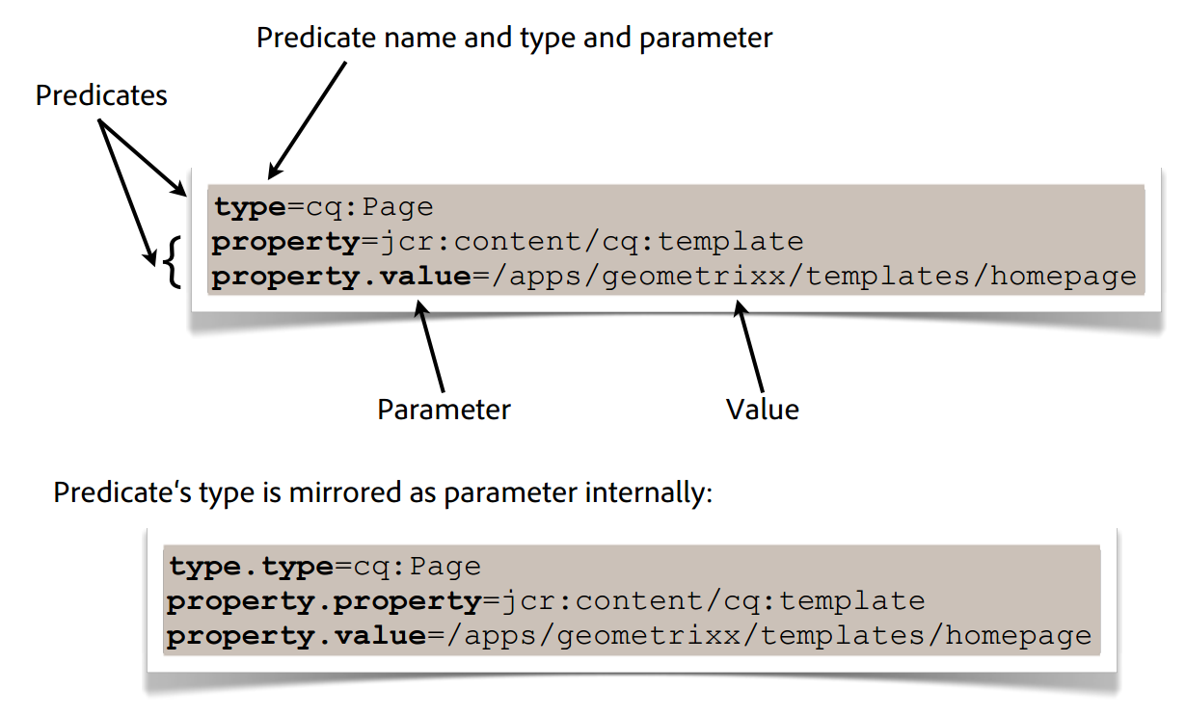
What predicate is?

Slide 9
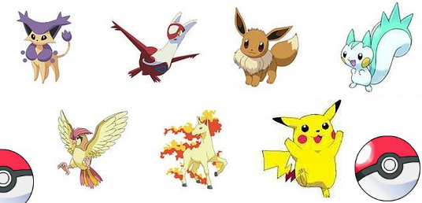
Predicates from the box.

Slide 10
Most Popular
path : This is used to search under a particular hierarchy only.
path.self=true : If true searches the subtree including the main node given in path, if false searches the subtree only.
path.exact=true : If true exact path is matched, if false all descendants are included.
path.flat=true : If true searches only the direct children .
type: It is used for searching for a particular nodetype only.
property: This is used to search for a specific property only.
property.value : the property value to search .
property.depth : The number of additional levels to search under a node. eg. if property.depth=2 then the property is searched under
property.and : If multiple properties are present , by default an OR operator is applied. If you want an AND , you may use property.and=true
property.operation : “equals” for exact match (default), “unequals” for unequality comparison, “like” for using the jcr:like xpath function , “not” for no match , (value param will be ignored) or “exists” for existence match .(value can be true – property must exist).

Slide 11
Most Popular
fulltext: It is used to search terms for fulltext search
fulltext.relPath : the relative path to search in (eg. property or subnode) eg. fulltext.relPath=jcr:content or fulltext.relPath=jcr:content/@cq:tags
daterange : This predicate is used to search a date property range.
daterange.property : Specify a property which is searched.
daterange.lowerBound : Fix a lower bound eg. 2010-07-25
daterange.lowerOperation : “>” (default) or “>=”
daterange.upperBound: Fix a lower bound eg. 2013-07-26
daterange.upperOperation: “<” (default) or “<=”
relativedaterange: It is an extension of daterange which uses relative offsets to server time. It also supports 1s 2m 3h 4d 5w 6M 7y
relativedaterange.lowerBound : Lower bound offset, default=0
relativedaterange.upperBound : Upper bound Offset .

Slide 12
Most Popular
nodename: This is used to search exact nodenames for the result set. It allows few wildcards like: nodename=text* will search for any character or no character after text. nodename=text? will search for any character after text.
tagid: This predicate is used to search for a particular tag on a page. You may specify the exact tagid of a tag in this predicate
tagid.property: this may be used to specify the path of node where tags are stored.
group: This predicate is used to create logical conditions in your query. You can create complex conditions using OR & AND operators in different groups. e.g:
path=/home/users
type=rep:User
group.1_daterange.property=jcr:created
group.1_daterange.lowerBound=2015-08-18
group.1_daterange.upperBound=2016-08-19
group.2_daterange.property=cq:lastModified
group.2_daterange.lowerBound=2015-08-18
group.2_daterange.upperBound=2016-08-19
group.p.or=true

Slide 13
Most Popular
orderBy: This predicate is used to sort the result sets obtained in the query. e.g. orderby=@jcr:score or orderby=@jcr:content/cq:lastModified
orderby.sort: You may define the sorting way for the search results e.g. desc for descending and “” for ascending.
orderby:path : this can also be used to sort by path.
p.hits=full: Use this when you want to return all the properties in a node.Example
p.hits=selective: Use this if you want to return selective properties in search result. Use this with
p.properties=sling:resourceType jcr:primaryType Example
p.nodedepth: Use this when you need properties of a node and its child nodes in the same search result. Use this with p.hits=full Example
p.facets=true : This will be used to Search Facets based search for the assigned Query. If you want to calculate the count of tags which are present in your search result or you want to know how many templates for a particular page are there etc, you may go with Facets based search . Example

Slide 14
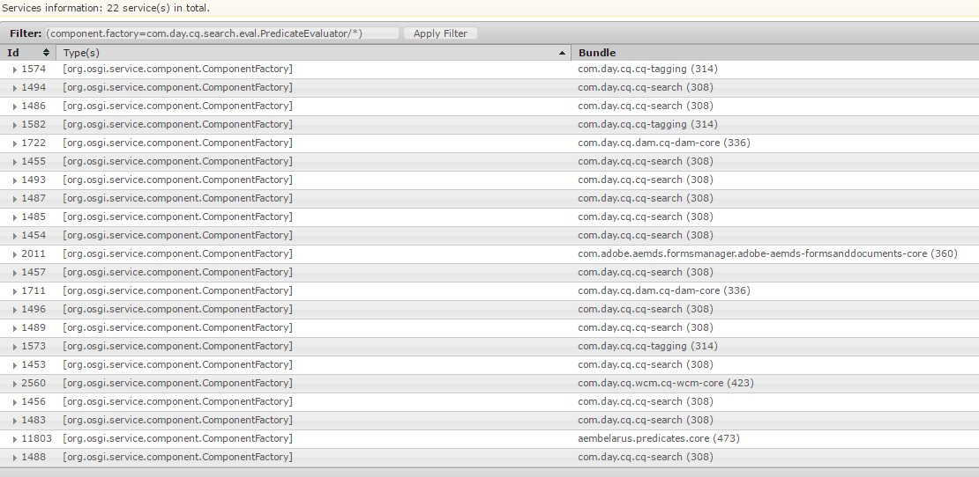
Gotta Catch ‘Em All !
http://localhost:4502/system/console/services?filter=%28component.factory%3Dcom.day.cq.search.eval.PredicateEvaluator%2F*%29
https://docs.adobe.com/docs/en/aem/6-1/ref/javadoc/com/day/cq/search/eval/PredicateEvaluator.html

Slide 15
Sample Queries
Search for pages tagged with a certain tag
querybuilder
querydebug
Search under multiple paths (using groups)
querybuilder
querydebug
Specify p.hits=full, in which case all properties will be included for each node:
querybuilder
querydebug

Slide 16

Custom Predicates

Slide 17
Predicate types
XPath Predicate
This is used to create a Backend XPATH Query using the new custom predicates which can be defined as per need. Many of the inbuilt CQ predicates are XPATH predicates.
Predicate Evaluator
canXpath() - true
canFilter() - false
Filter Predicate
This predicate is used whenever you want to Filter out some results which are not needed in the end Search Result
Predicate Evaluator
canXpath() - false
canFilter() - true

Slide 18
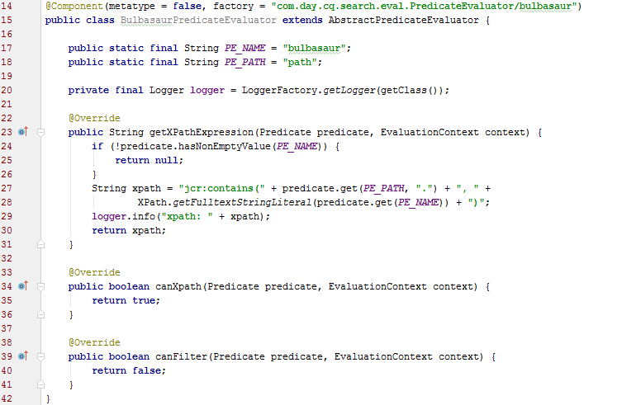
Custom Predicate

Slide 19
Custom Predicate
Predicate name
@Component(metatype = false, factory = "com.day.cq.search.eval.PredicateEvaluator/bulbasaur")
public class BulbasaurPredicateEvaluator extends AbstractPredicateEvaluator {
Predicate implementation
@Override
public String getXPathExpression(Predicate predicate, EvaluationContext context) {
if (!predicate.hasNonEmptyValue(PE_NAME)) {
return null;
a }
String xpath = "jcr:contains(" + predicate.get(PE_PATH, ".") + ", " +
XPath.getFulltextStringLiteral(predicate.get(PE_NAME)) + ")";
logger.info("xpath: " + xpath);
return xpath;
}

Slide 20
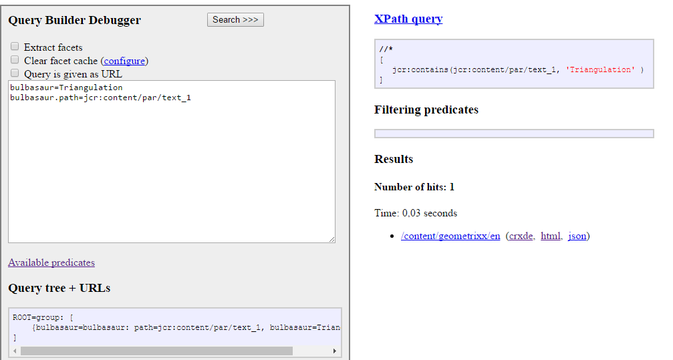
Custom Predicate
querybuilder querydebugger

Slide 21

Debugging

Slide 22
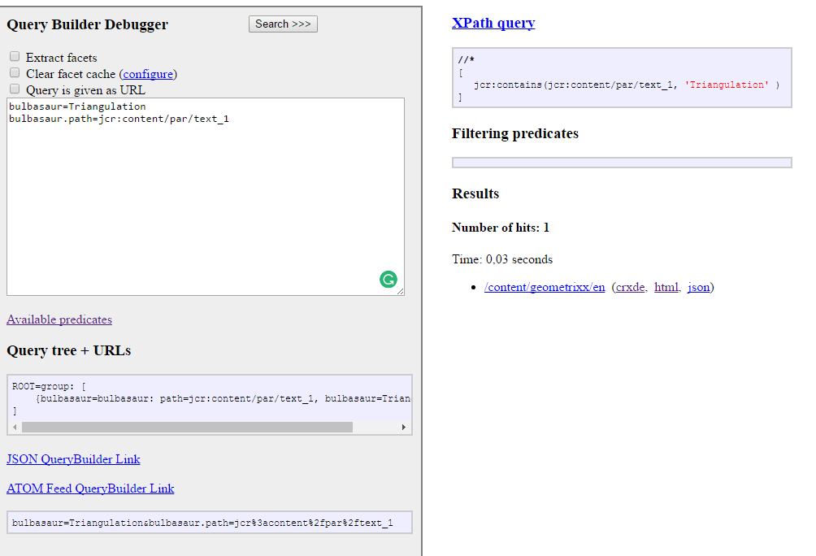
Query Builder Debugger

Slide 23
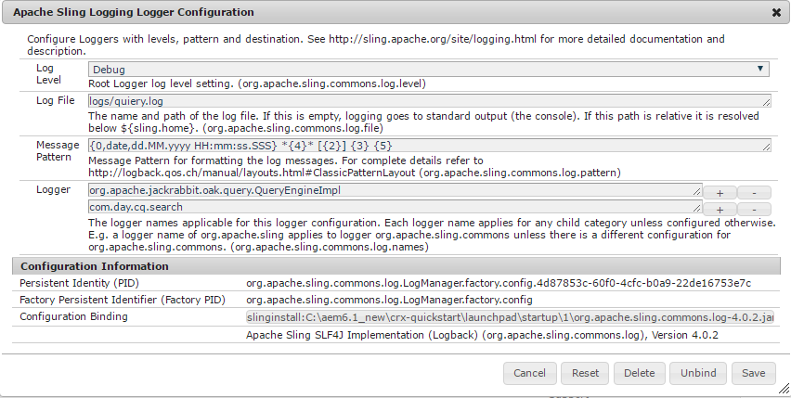
Logs Setup And Monitor
com.day.cq.search
org.apache.jackrabbit.oak.query.QueryEngineImpl

Slide 24
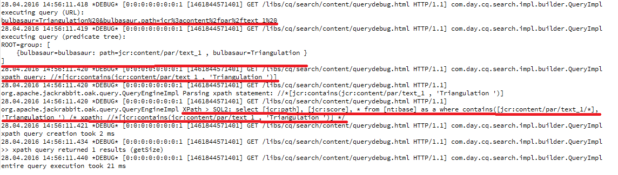
Logs Setup And Monitor

Slide 25
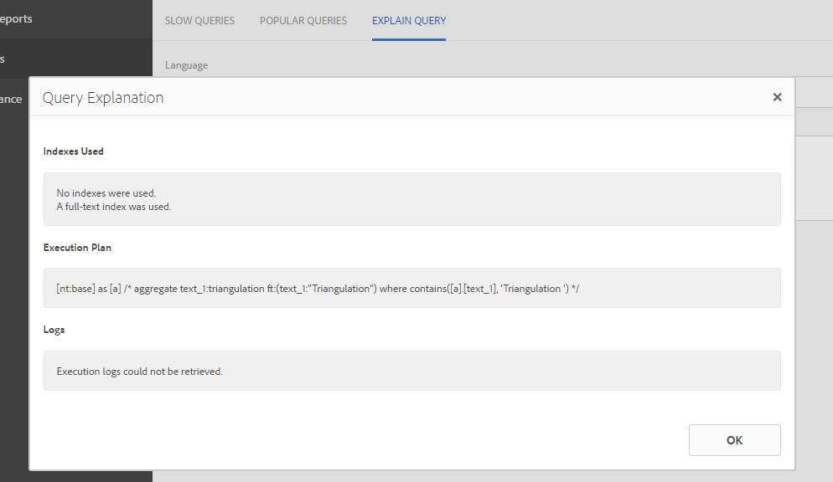
Query Analyzer
http://localhost:4502/libs/granite/operations/content/diagnosis/tool.html/_granite_queryperformance //*[jcr:contains(@text_1 , 'Triangulation ')]

Slide 26
Links
https://docs.adobe.com/docs/en/aem/6-2/develop/search/querybuilder-api.html
http://www.slideshare.net/alexkli/cq5-querybuilder-adapttoberlin-2011
https://hashimkhan.in/aem-adobecq5-code-templates/query-builder/
http://aemtipsandtricks.blogspot.com.by/2014/07/structuring-content-for-faceted.html
https://hashimkhan.in/tag/predicate/

